Slide 1
Starbucks Drinks

Slide 2
Project of Contents
01
Data Collection
02
Read Data
03
Understand Data
04
Exploratory Data Analysis (EDA)

Slide 3
01
Data Collection

Slide 4
Kaggle
https://www.kaggle.com/datasets/syedasimalishah/starbucks-drinks

Slide 5
02
Read Data

Slide 6

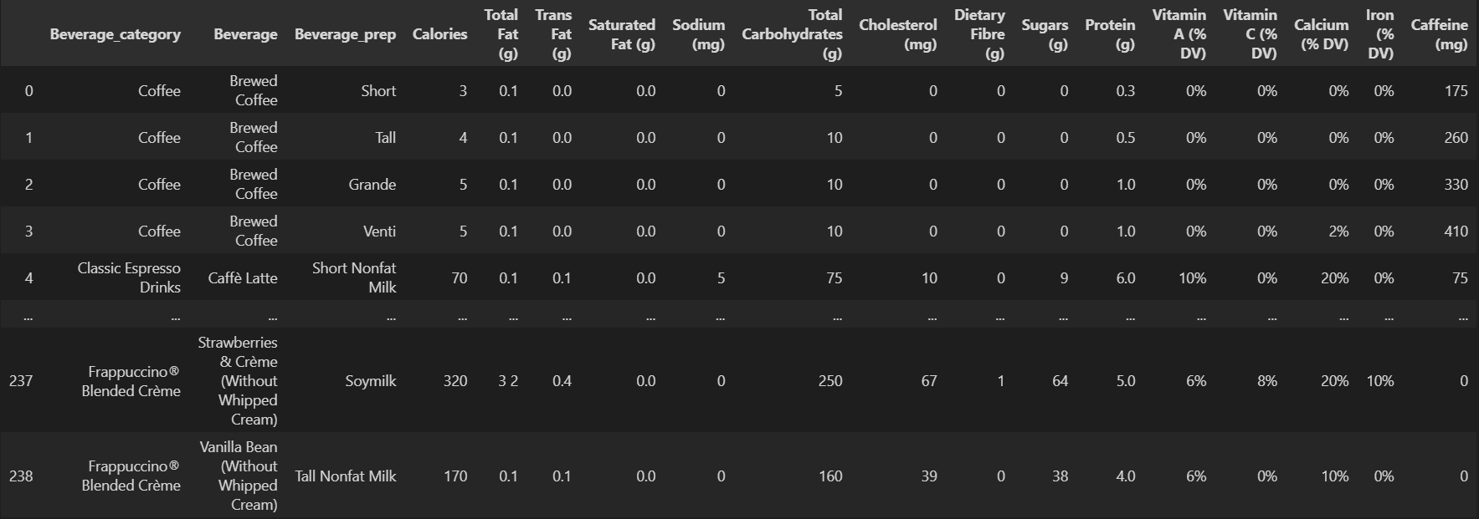

Slide 7
03
Understand Data

Slide 8
Describe Data :
1. Beverage_category: The category to which the beverage belongs (e.g., coffee, tea, smoothie).
2. Beverage: The specific name of the beverage.
3. Beverage_prep: The preparation type of the beverage (e.g., with milk, iced).
4. Calories: The total calorie content of the beverage.
5. Total_Fat_(g): The total fat content in grams.
6. Trans_Fat_(g): The amount of trans fat in grams.
7. Saturated_Fat_(g): The amount of saturated fat in grams.
8. Sodium_(mg): The sodium content in milligrams.
9. Total_Carbohydrates_(g): The total carbohydrate content in grams.
10. Cholesterol_(mg): The cholesterol content in milligrams.
11. Dietary_Fibre_(g): The dietary fiber content in grams.
12. Sugars_(g): The sugar content in grams.
13. Protein_(g): The protein content in grams.
14. Vitamin_A_(%_DV) : Percentage of daily Vitamin A value.
Benefits: Supports vision, immune function, and skin health.
15. Vitamin_C_(%_DV): Percentage of daily Vitamin C value.
Benefits: Boosts immune function, antioxidant protection, and enhances iron absorption.
16. Calcium_(%_DV): Percentage of daily Calcium value.
Benefits: Strengthens bones and teeth, supports muscle function, and nerve signaling.
17. Iron_(%_DV): Percentage of daily Iron value.
Benefits: Essential for oxygen transport in blood, prevents anemia, and supports energy levels.
18. Caffeine_(mg): The caffeine content in milligrams.

Slide 9
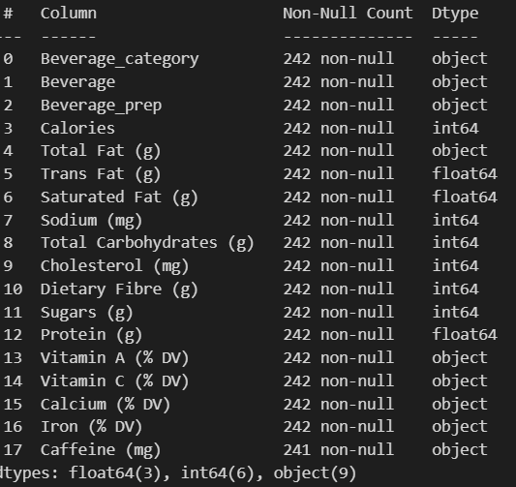
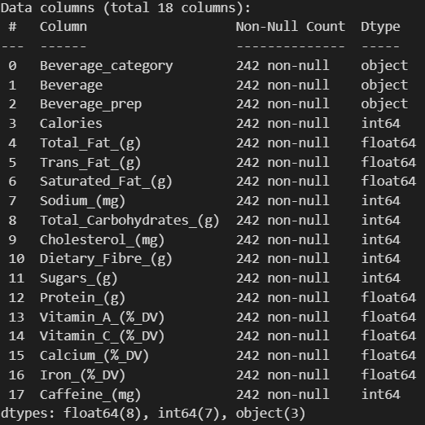

Slide 10
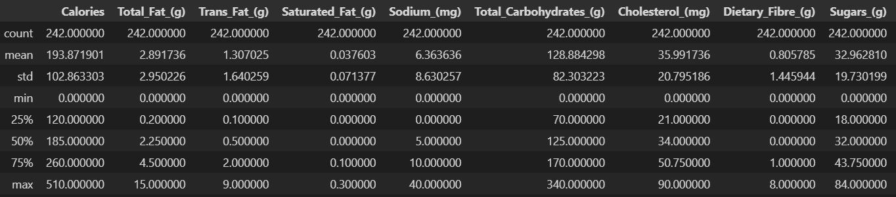
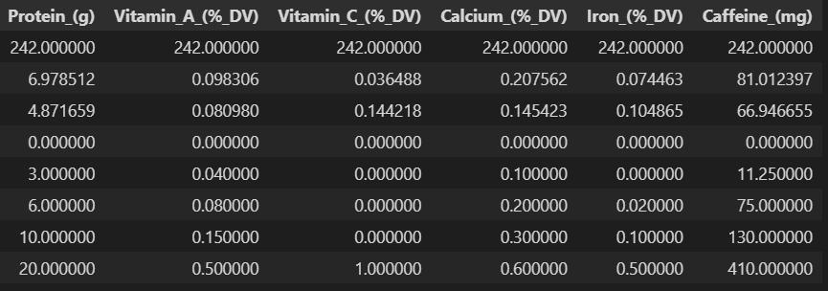

Slide 11
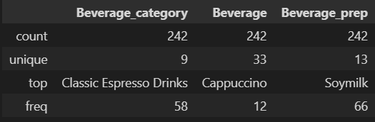

Slide 12
04
Exploratory Data Analysis (EDA)

Slide 13
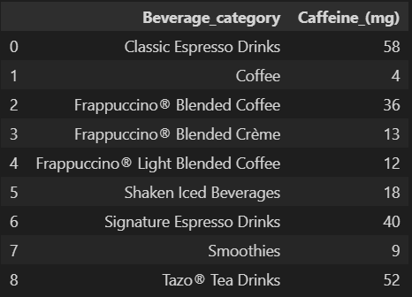
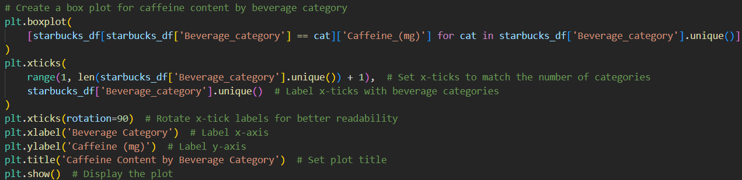
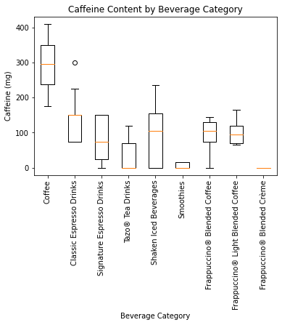
1) How do caffeine counts vary across different beverage categories?

Slide 14
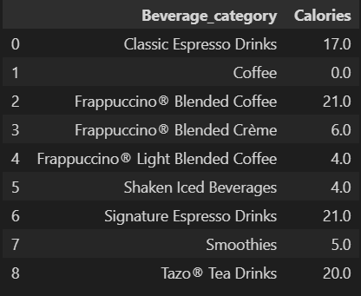
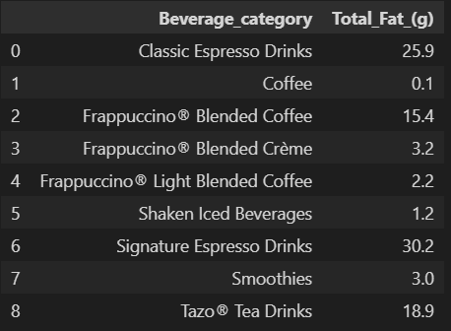
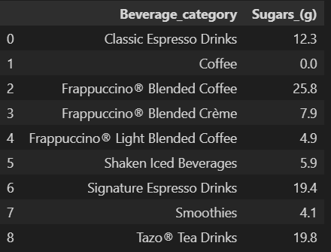
2) How do different beverage categories compare in terms of calories, fat and sugar content?

Slide 15
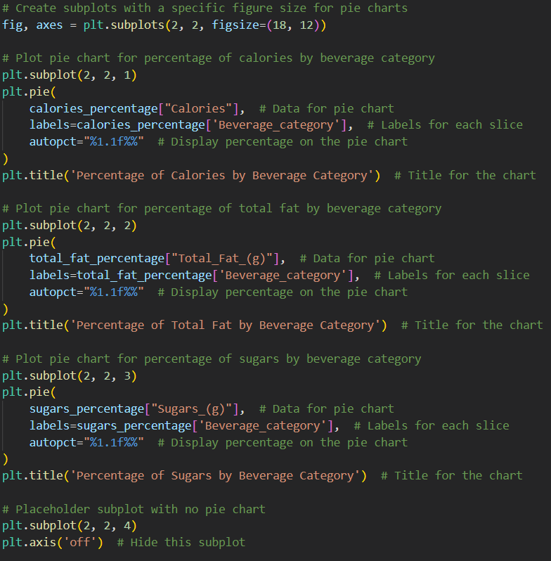
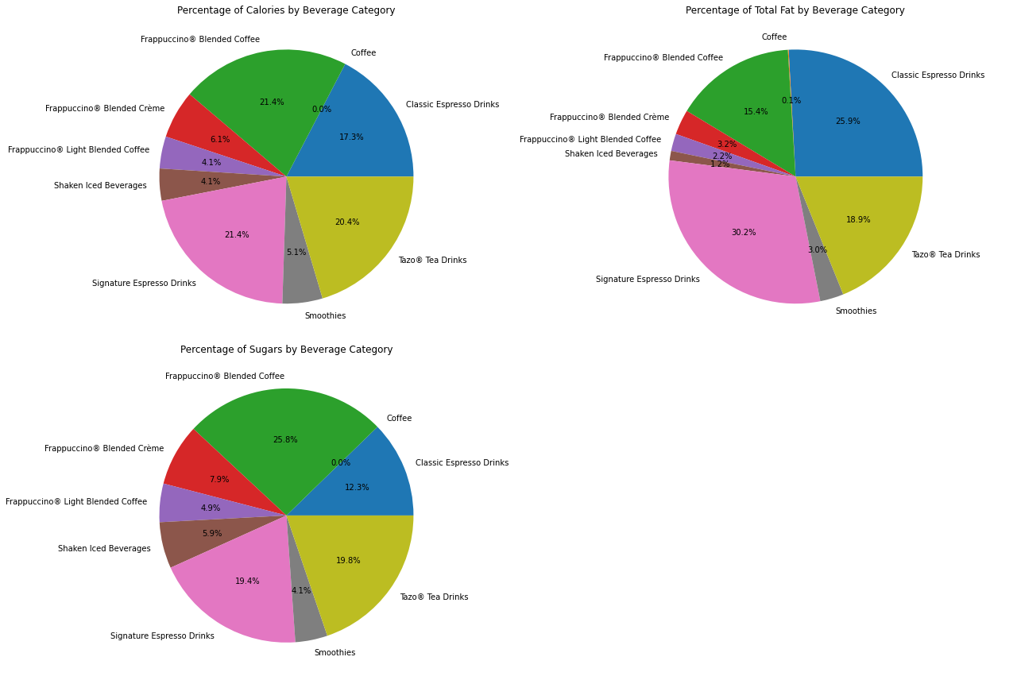


Slide 16
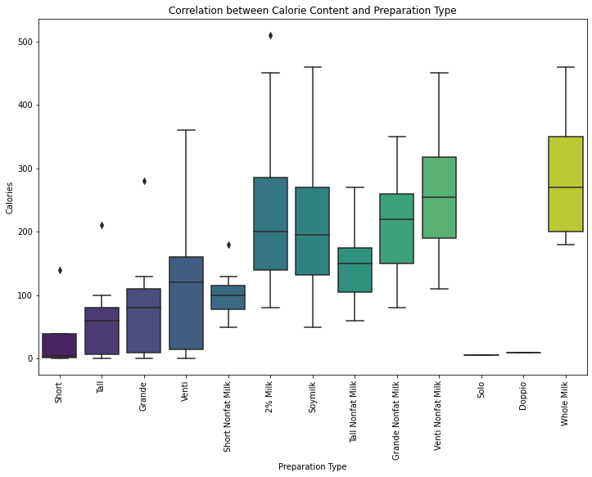
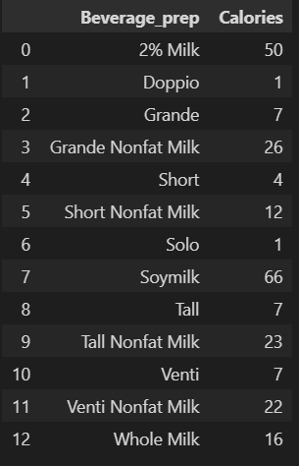
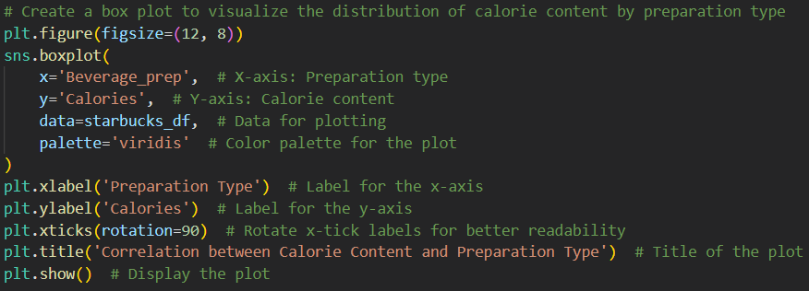
3) Is there a correlation between calorie content and the type of beverage preparation?

Slide 17
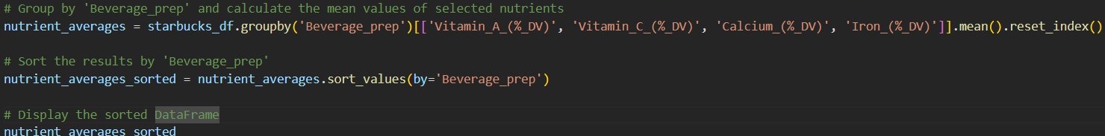
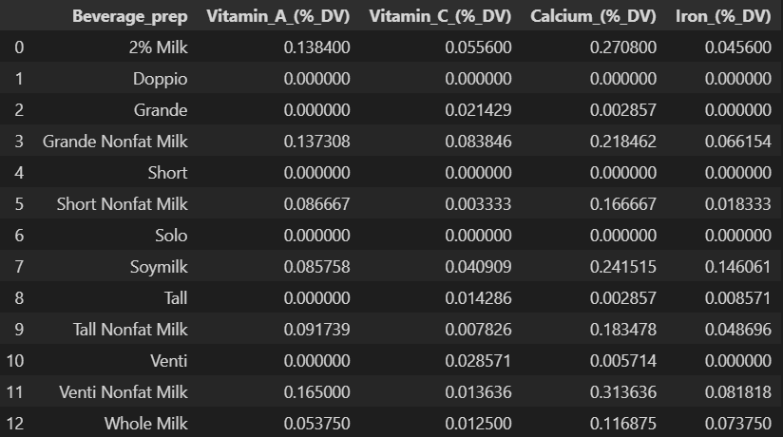
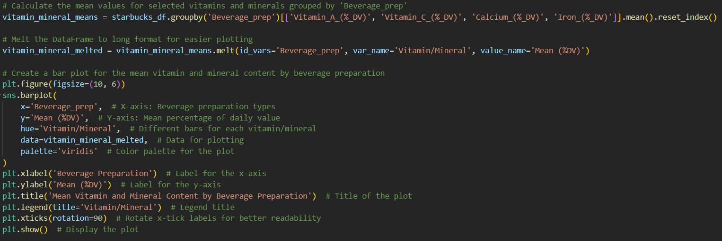
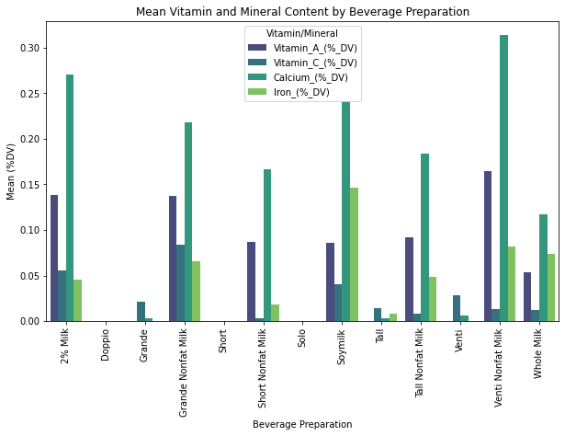
4) What is the impact of different beverage preparations on the vitamin A , C , Calcium and Iron content?

Slide 18
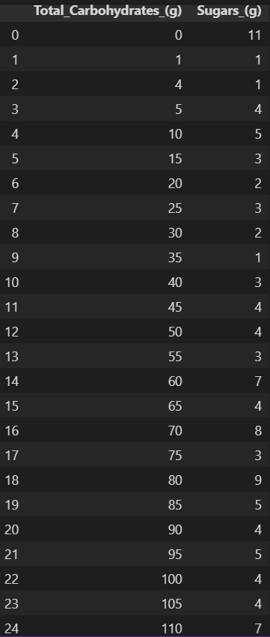
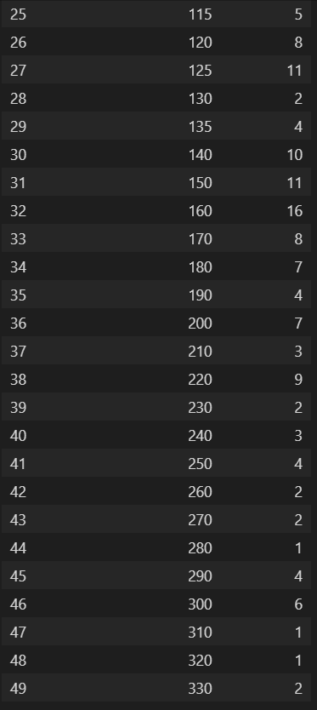
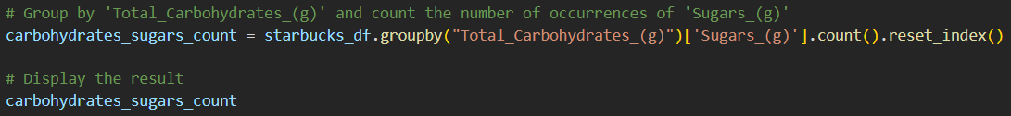
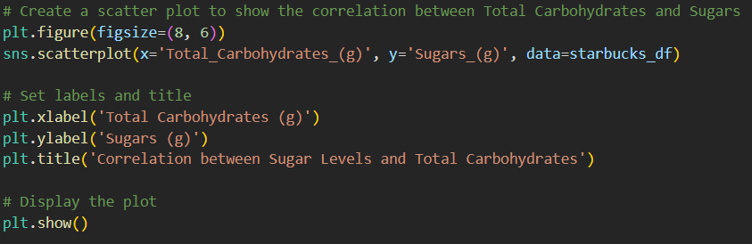
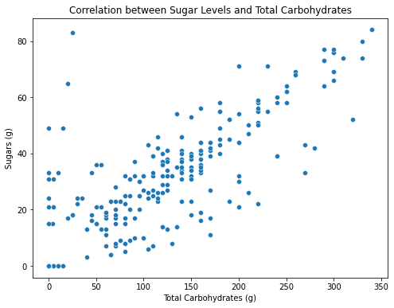
5) How do sugar levels correlate with total carbohydrates in the drinks?

Slide 19
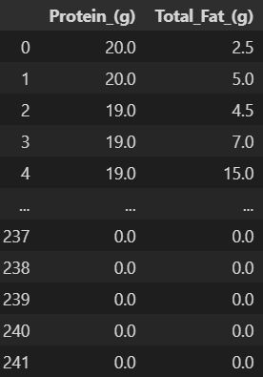
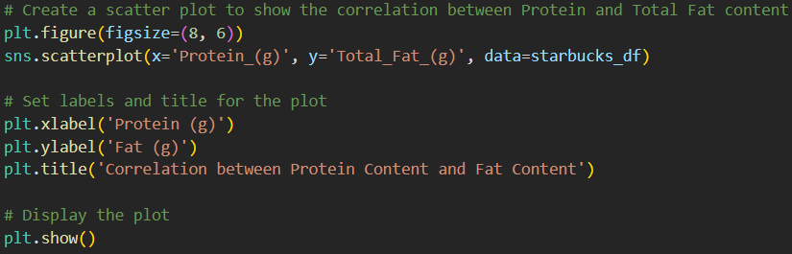
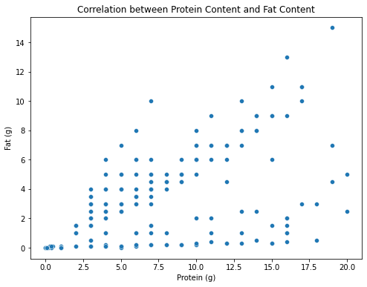
6) Do beverages with higher protein content also have higher fat content?

Slide 20
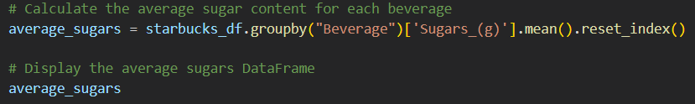
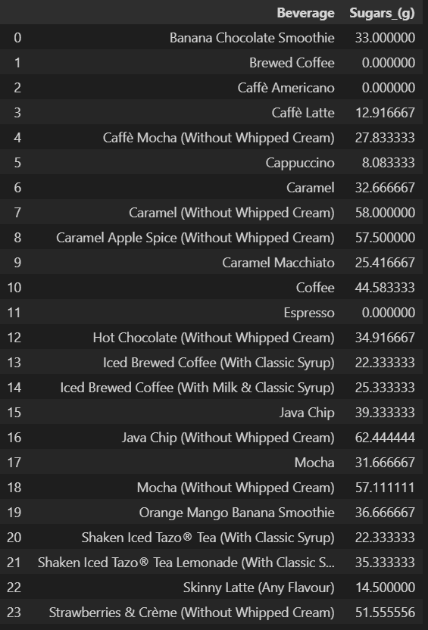
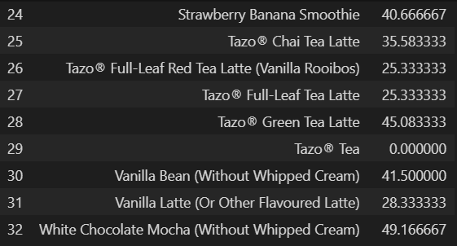
7) What is the average of sugars found in Starbucks beverages?

Slide 21
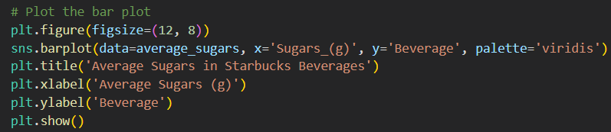
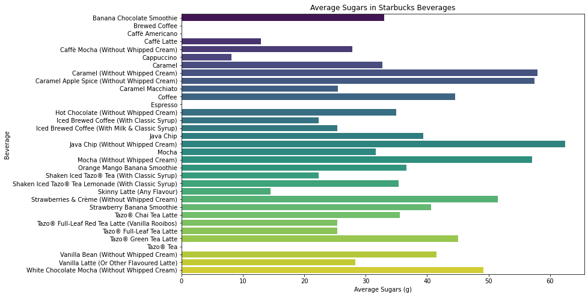

Slide 22
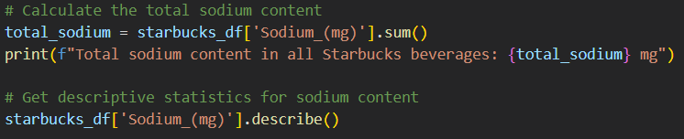
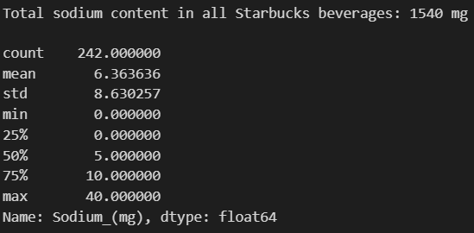
8) How much sodium is present in Starbucks beverages, and what are the average sodium levels?

Slide 23
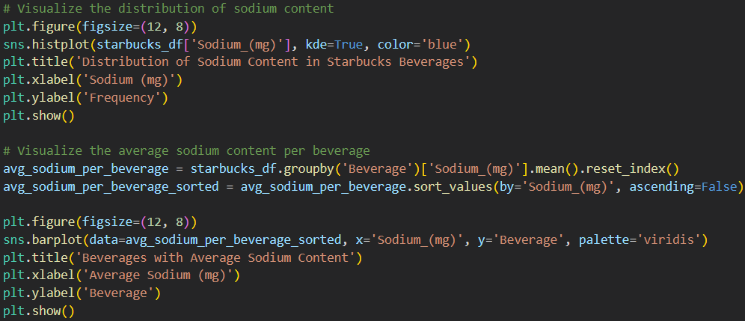
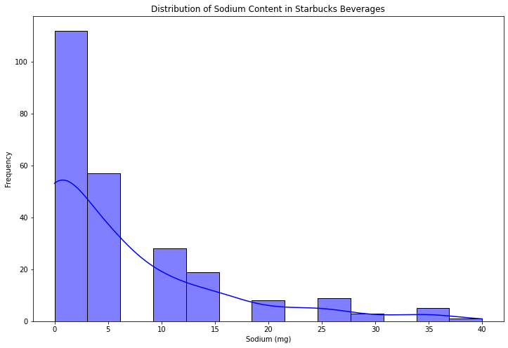
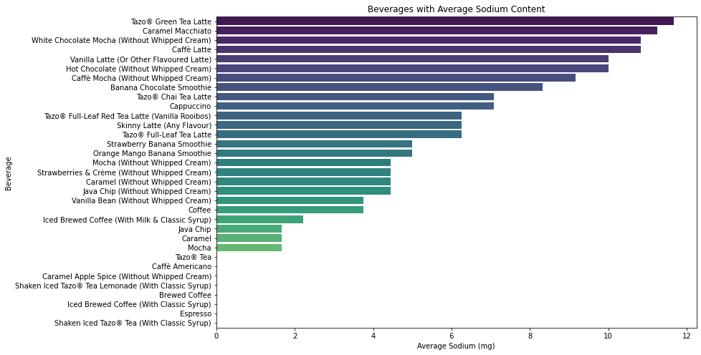

Slide 24
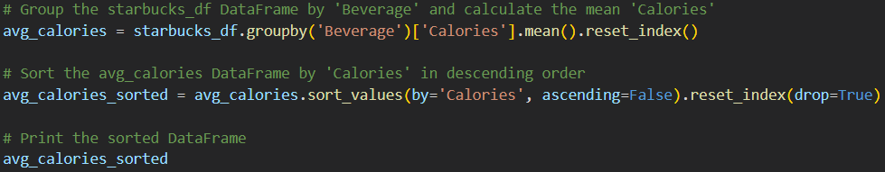
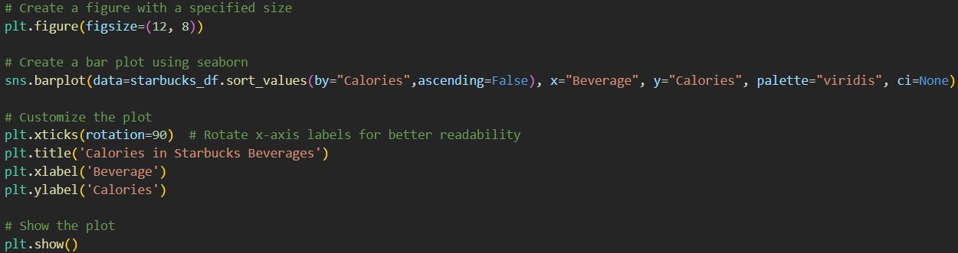
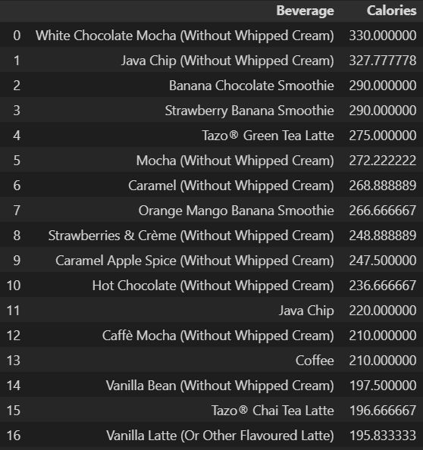
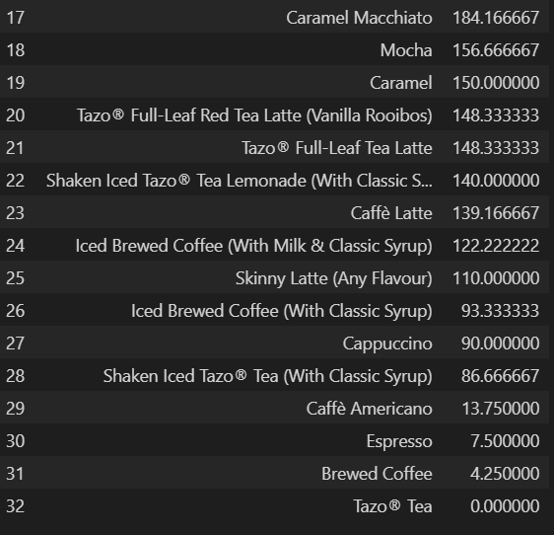
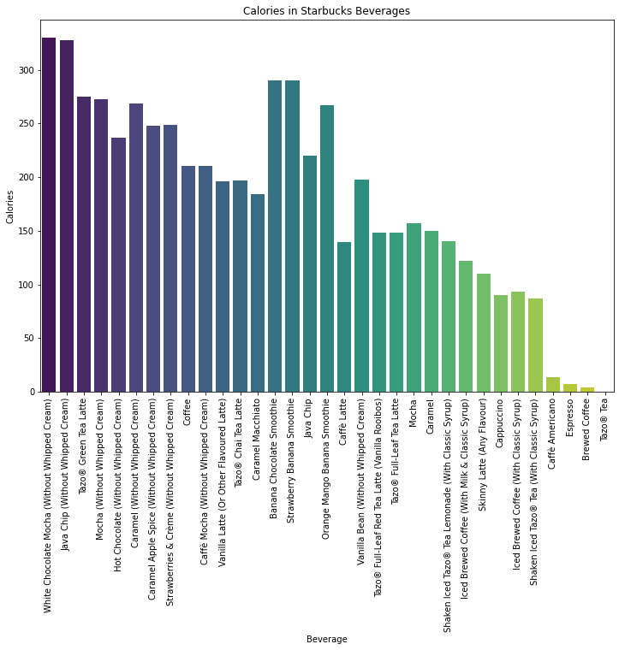
9) Which beverages have the highest average calorie content?

Slide 25
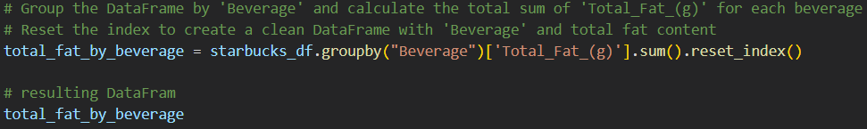
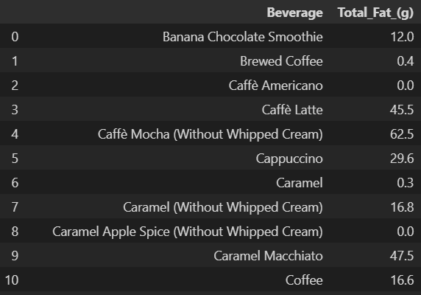
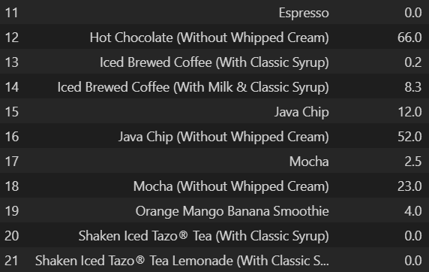
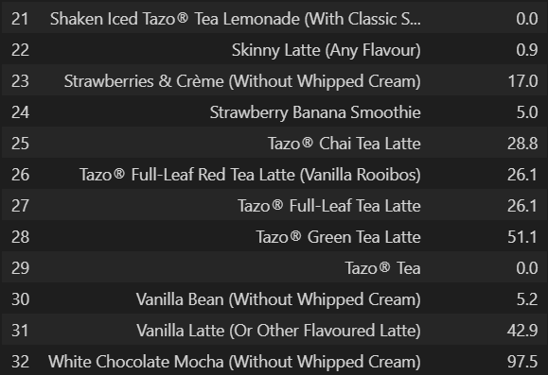
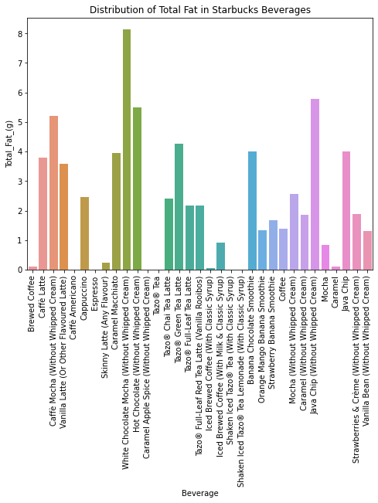
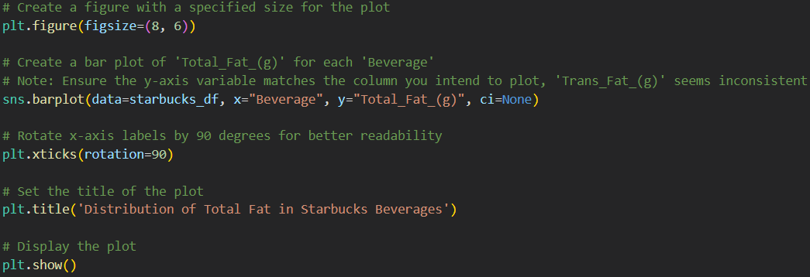
10) What is the distribution of total fat across all beverages?

Slide 26





11) What is the relationship between calories and total fat in Starbucks beverages?

Slide 27





12) Which beverages have the highest average cholesterol content?

Slide 28



13) Which beverages contain the 10 highest amount of caffeine?

Slide 29


14) Are there specific beverage categories that tend to have higher levels of certain nutrients (Vitamin A, Vitamin C, calcium, iron)?

Slide 30



Slide 31



15) Which beverage are the healthiest in terms of protein and dietary fiber content?

Slide 32



Slide 33
Thanks

